Slide 1
Grounding & Bonding
NEC §100 Purpose of Grounding
Grounding is one of the means of safeguarding employees, and the public from injury;
Grounding also allows protective devices to operate during a fault condition;
The basic theory behind grounding is to keep the voltage of grounded parts as close as possible to the potential of earth, so that a voltage difference does not exist between a person and a grounded metal object.
York County Amateur Radio Club 2023/2/05
n1xp

Slide 2
Grounding & Bonding
An Electrical Ground is for safety and surge/lightning protection and is not an RF ground;
Electrical Grounding & Bonding is defined in NEC §100 and specified by NEC §250;
“Grounding” is the connection of a conductor to EARTH through the grounding electrode;
“Bonding” is connecting two or more “grounding” conductors together
York County Amateur Radio Club 2023/2/05
n1xp

Slide 3
Grounding & Bonding
§250 (A) Grounded Systems
(1) Electrical System Grounding. Electrical system that are grounded shall be connected to earth in a manner that will limit the voltage imposed by lightning, line surges, or unintentional contact with higher-voltage lines and that will stabilize the voltage to earth during normal operation.
York County Amateur Radio Club 2023/2/05
n1xp

Slide 4
Grounding & Bonding
§250 (A) Grounded Systems
(2) Grounding of Electrical Equipment. Normally non-current carrying conductive materials enclosing electrical conductors or equipment, or forming part of such equipment, shall be connected to earth so as to limit the voltage to ground on these materials
York County Amateur Radio Club 2023/2/05
n1xp

Slide 5
Grounding & Bonding
§250 (A) Grounded Systems
(3) Bonding of Electrical Equipment. Normally non-current carrying conductive materials enclosing electrical conductors or equipment, shall be connected together and to the electrical supply source in a manner that established an effective ground-fault current path.
York County Amateur Radio Club 2023/2/05
n1xp

Slide 6
Grounding & Bonding
Informational Note to §250 (A) (1).
An important consideration for limiting the imposed voltage is the routing of bonding and grounding electrode conductors so they are not any longer than necessary to complete the connection without disturbing the permanent parts of the installation and so that unnecessary bends and loops are avoided.
York County Amateur Radio Club 2023/2/05
n1xp

Slide 7
Grounding & Bonding
NEW REQUIREMENT – NEC 2020
Section 230.67(a) – DWELLINGS
All services supplying dwelling units shall be provided with a surge protection device (SPD)
Sensitive electronics and systems found in modern appliances, safety devices (IE: GFCI outlets), smoke alarms, and other equipment in homes, apartments, and other dwellings warrant protection by surge protection devices. If compromised by surges, these systems may be damaged or fail to operate, posing economic and safety concerns.
A Type 1 or Type 2 SPD must be installed at or near the service entrance panel.
York County Amateur Radio Club 2023/2/05
n1xp

Slide 8
Grounding & Bonding
NEC Informational Note 800(a)
Chapter 8 of the NEC requires all communication systems entering a building or structure to be grounded to the electrical system ground (single point ground)
Service
Equipment
Intersystem bonding
Termination or connection to building grounding means
Communications
Equipment,
Protector
Or shield
Bonding Conductor
Power Service
Grounding electrode
conductor
Grounding Electrode
York County Amateur Radio Club 2023/2/05
n1xp

Slide 9
Grounding & Bonding
NEC Informational Note 800(b)
Service
Equipment
Communications
Equipment,
Protector
Or shield
Bonding Conductor
Power Service
Grounding electrode
conductor
Grounding electrode
conductor
Grounding Electrodes
York County Amateur Radio Club 2023/2/05
n1xp

Slide 10
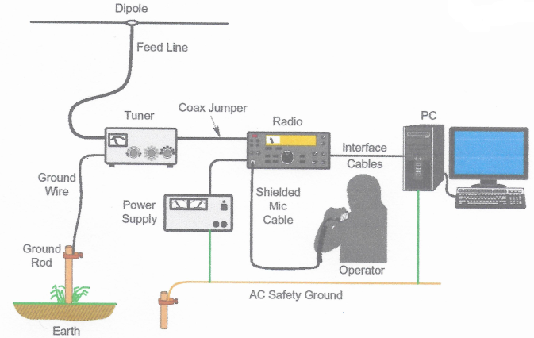
Grounding & Bonding
NO!!!
1. No Lightning Protection/
Entrance Panel
2. Ground Rods Not Bonded
3. No bonding to Electrical Entrance ground electrode
York County Amateur Radio Club 2023/2/05
n1xp

Slide 11
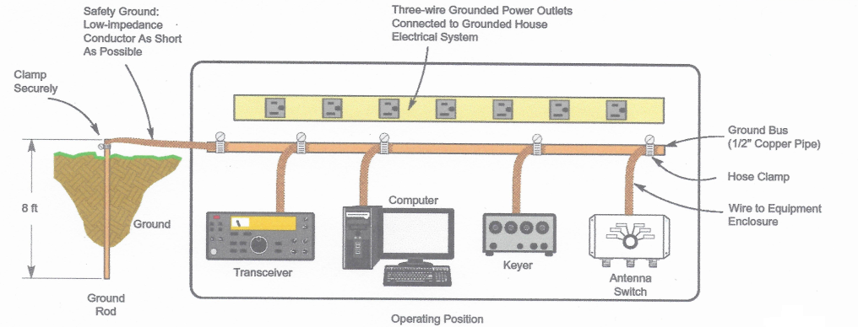
Grounding & Bonding
NO!!!
York County Amateur Radio Club 2023/2/05
n1xp

Slide 12
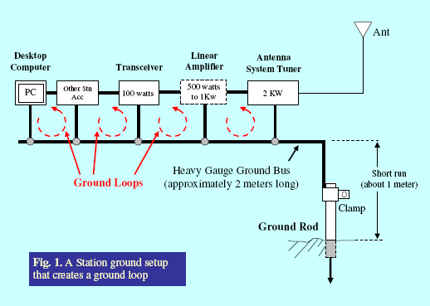
Grounding & Bonding
WHY PREVIOUS SLIDES ARE INCORRECT
GROUNDING ELECTRODE NOT BONDED TO SERVICE ENTRANCE
GROUND BUS TOO LONG
EQUIPMENT BONDING WIRE DIFFERENT LENGTHS
GROUND LOOPS CREATE UNEQUAL POTENTIAL BETWEEN EQUIPMENT DURING SURGE CONDITIONS
GROUND LOOPS MAY CAUSE FAULTY EQUIPMENT OPERATION UNDER NORMAL CONDITIONS
York County Amateur Radio Club 2023/2/05
n1xp

Slide 13
Grounding & Bonding
WHAT IS CORRECT?
BETTER – BUT IS IT GOOD ENOUGH?
EACH BONDING CONDUCTOR SHOULD BE EQUAL LENGTH
York County Amateur Radio Club 2023/2/05
n1xp

Slide 14
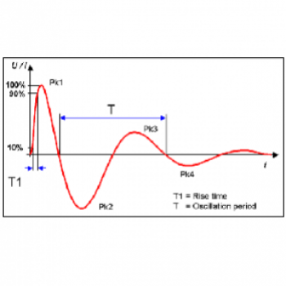
Grounding & Bonding
CONSIDER A POWER LINE SURGE - 100 kHz RING WAVE OF 4kV / 2kA
(IEEE C62.41, TYPICAL POWER-LINE SURGE)
USING OHMS LAW: E = I x R
IF ONE EQUIPMENT BONDING WIRE IS 0.05Ω
2,000 x 0.05 = 100 V
IF SECOND EQUIPMENT BONDING WIRE IS 0.25Ω
2,000 X 0.25 = 500 V
VOLTAGE DIFFERENCE BETWEEN THE TWO IS
500 – 100 = 400 V
USING TRUE IMPEDANCE jX VOLTAGE WILL BE GREATER
T1 = 1.2µS
T = 200µS
York County Amateur Radio Club 2023/2/05
n1xp

Slide 15
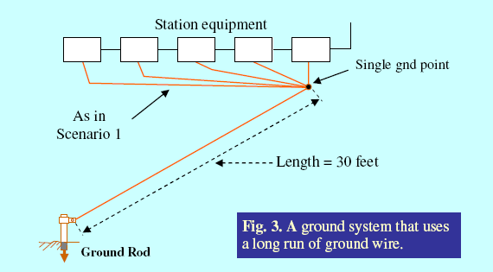
Grounding & Bonding
ANOTHER COMMON MISTAKE
York County Amateur Radio Club 2023/2/05
n1xp

Slide 16
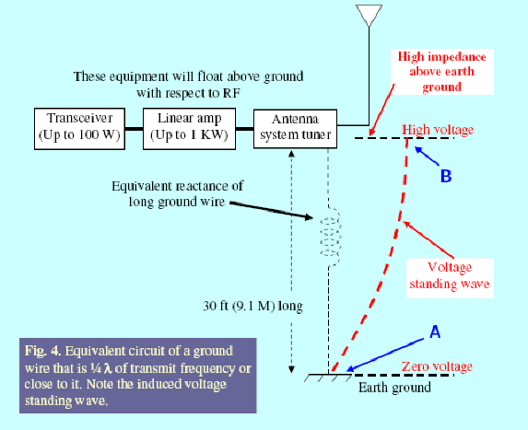
Grounding & Bonding
York County Amateur Radio Club 2023/2/05
n1xp

Slide 17
Grounding & Bonding
EXAMPLE OF “SINGLE-POINT PANEL” IN PRESENTATION GIVEN AT 2016 DAYTON HAMFEST
WHAT’S WRONG?
NO BONDING OF GROUND ELECTRODE TO ELECTRICAL SERVICE ELECTRODE
NO SURGE PROTECTION ON CONTROL WIRES
DISSIMILAR METALS
York County Amateur Radio Club 2023/2/05
n1xp

Slide 18
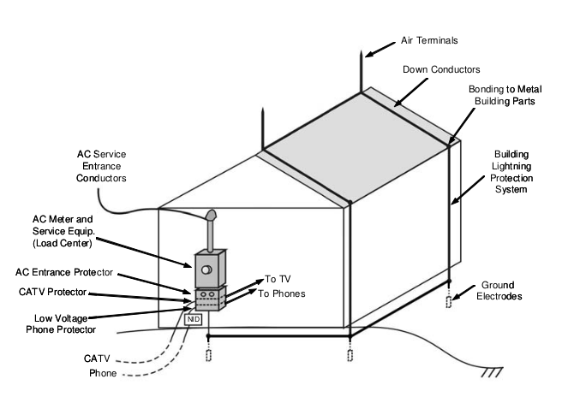
Grounding & Bonding
York County Amateur Radio Club 2023/2/05
n1xp

Slide 19
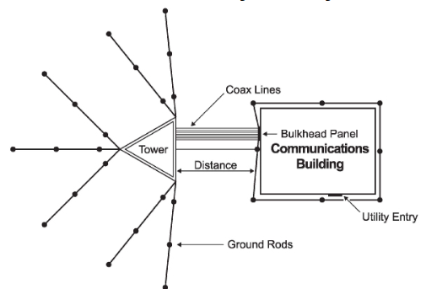
Grounding & Bonding
York County Amateur Radio Club 2023/2/05
n1xp

Slide 20
Grounding & Bonding
GROUNDING ELECTRODE
NEC §250.52 GROUNDING ELECTRODES
NEC §250.52 (A) (5) “… SHALL NOT BE LESS THAN 2.44 METERS (8FT) IN LENGTH…”
NEC §250.52 (A) (5) (b) “ROD TYPE GROUNDING ELECTRODES …. SHALL BE 15.87mm (5/8”) IN DIAMETER, UNLESS LISTED.
York County Amateur Radio Club 2023/2/05
n1xp

Slide 21
Grounding & Bonding
GROUNDING ELECTRODE
NEC §250.53 (A) (2) “SUPPLEMENTAL ELECTRODE REQUIRED. A SINGLE ROD, PIPE, OR PLATE ELECTRODE SHALL BE SUPPLEMENTED BY AN ADDITIONAL ELECTRODE.
EXCEPTION: If a single rod, pipe, or plate grounding electrode has a resistance to earth of 25 Ω or less, the supplemental electrode shall not be required.
York County Amateur Radio Club 2023/2/05
n1xp

Slide 22
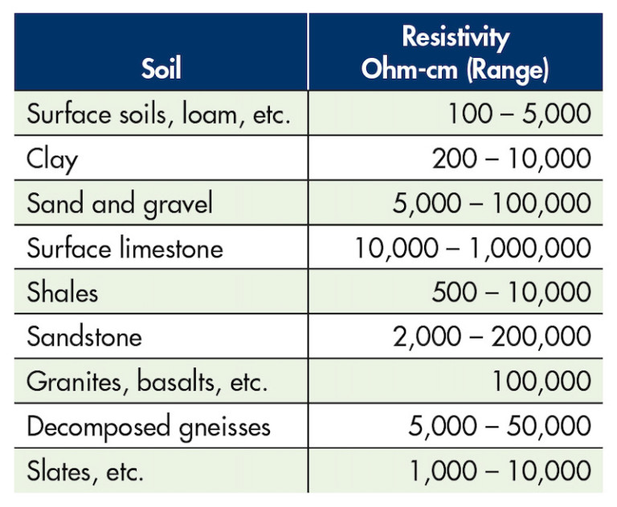
Grounding & Bonding
Earth Resistivity
York County Amateur Radio Club 2023/2/05
n1xp

Slide 23
Grounding & Bonding
Earth Resistivity Factors
Earth resistivity is determined by:
Contact resistances of the grounding conductor to the electrode
Type of grounding electrode
Number of grounding electrodes
Soil resistivity ( salt, mineral, and moisture content )
York County Amateur Radio Club 2023/2/05
n1xp

Slide 24
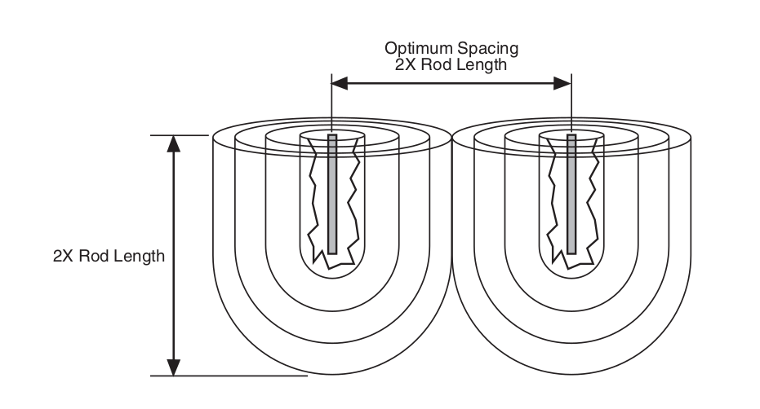
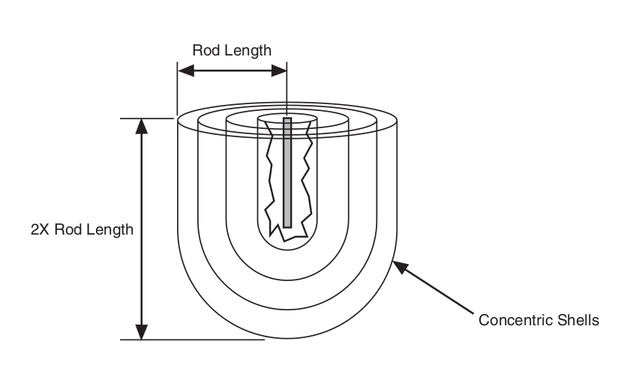
Grounding & Bonding
Why Measure Earth Resistivity?
Earth resistivity is used to estimate:
Ground impedance of a grounding system
Earth potential gradients to estimate step & touch voltages
York County Amateur Radio Club 2023/2/05
n1xp

Slide 25
Grounding & Bonding
Measuring Earth Resistivity
Several commercial test instruments available
CANNOT USE AN OHMMETER
Measurements:
Three-pole, Fall of Potential Method
Not Recommended – requires disconnecting grounding conductor
Four-pole Wenner Array
Simplest method
Four-pole Schlumberger Array
Most effective method
York County Amateur Radio Club 2023/2/05
n1xp

Slide 26
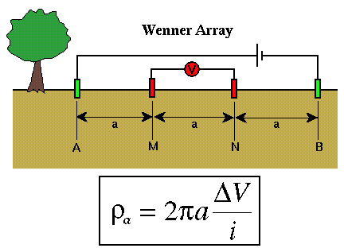
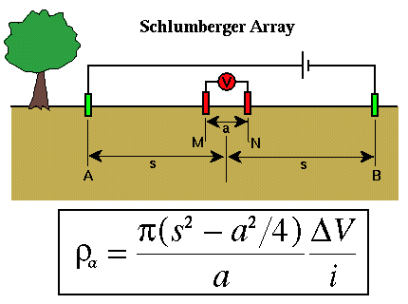
Grounding & Bonding
York County Amateur Radio Club 2023/2/05
n1xp

Slide 27
Grounding & Bonding
https://www.nfpa.org/NEC/About-the-NEC/Grounding-and-bonding
National Weather Service, Engineering Handbook No. 3 – Facilities, Chapter 11a – Lightning Protection https://w1yca.org/tech.html under the GROUNDING & BOUNDING category
National Electric Safety Code: §100, §200, &250, & §800
York County Amateur Radio Club 2023/2/05
n1xp

Slide 28
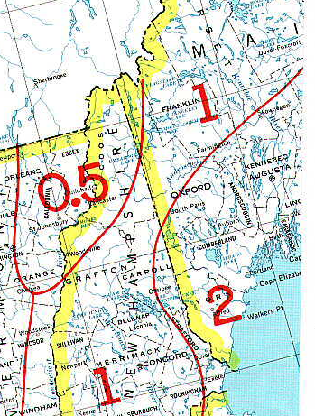
Grounding & Bonding
Earth Conductivity
Measured in millisiemens per meter
( mS/m )
Siemens is an SI unit of electrical conductance
S = 1 Ω⁻¹ ( 1 / Ω )
York County Amateur Radio Club 2023/2/05
n1xp

